Slide 1
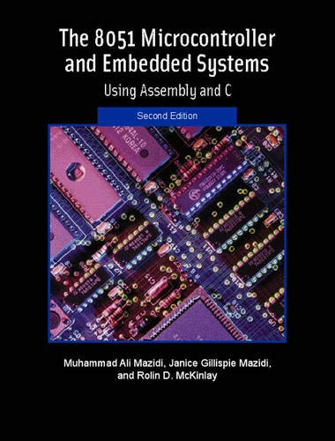
THE 8051
MICROCONTROLLER & Embedded Systems
Muhammad Ali Mazidi, Janice Mazidi
& Rolin McKinlay

Slide 2
I/O PORT
PROGRAMMING
Chapter 4

Slide 3
Objectives
Upon completion of this chapter, you will be able to:
>> List the 4 ports of the 8051
>> Describe the dual role of port 0 in providing both data and addresses
>> Code Assembly language to use the ports for input or output
>> Explain the dual role of port 0 and port 2
>> Code 8051 instructions for I/O handling
>> Code I/O bit-manipulation programs for the 8051

Slide 4
Objectives
Discussing the I/O port programming of the 8051,
Section 4.1, describing I/O access using byte-size data,
Section 4.2, bit manipulation of the I/O ports is discussed in detail.

Slide 5
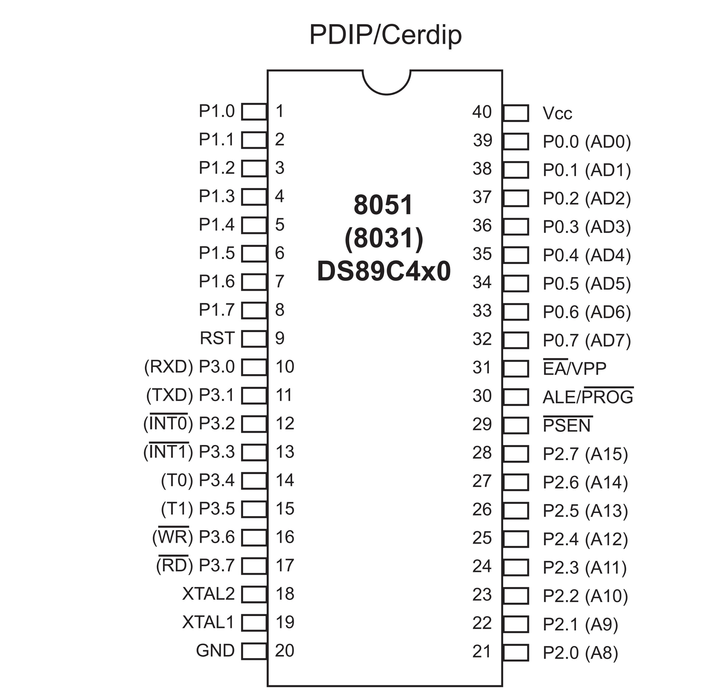
Figure 4-1. 8051 Pin Diagram

Slide 6
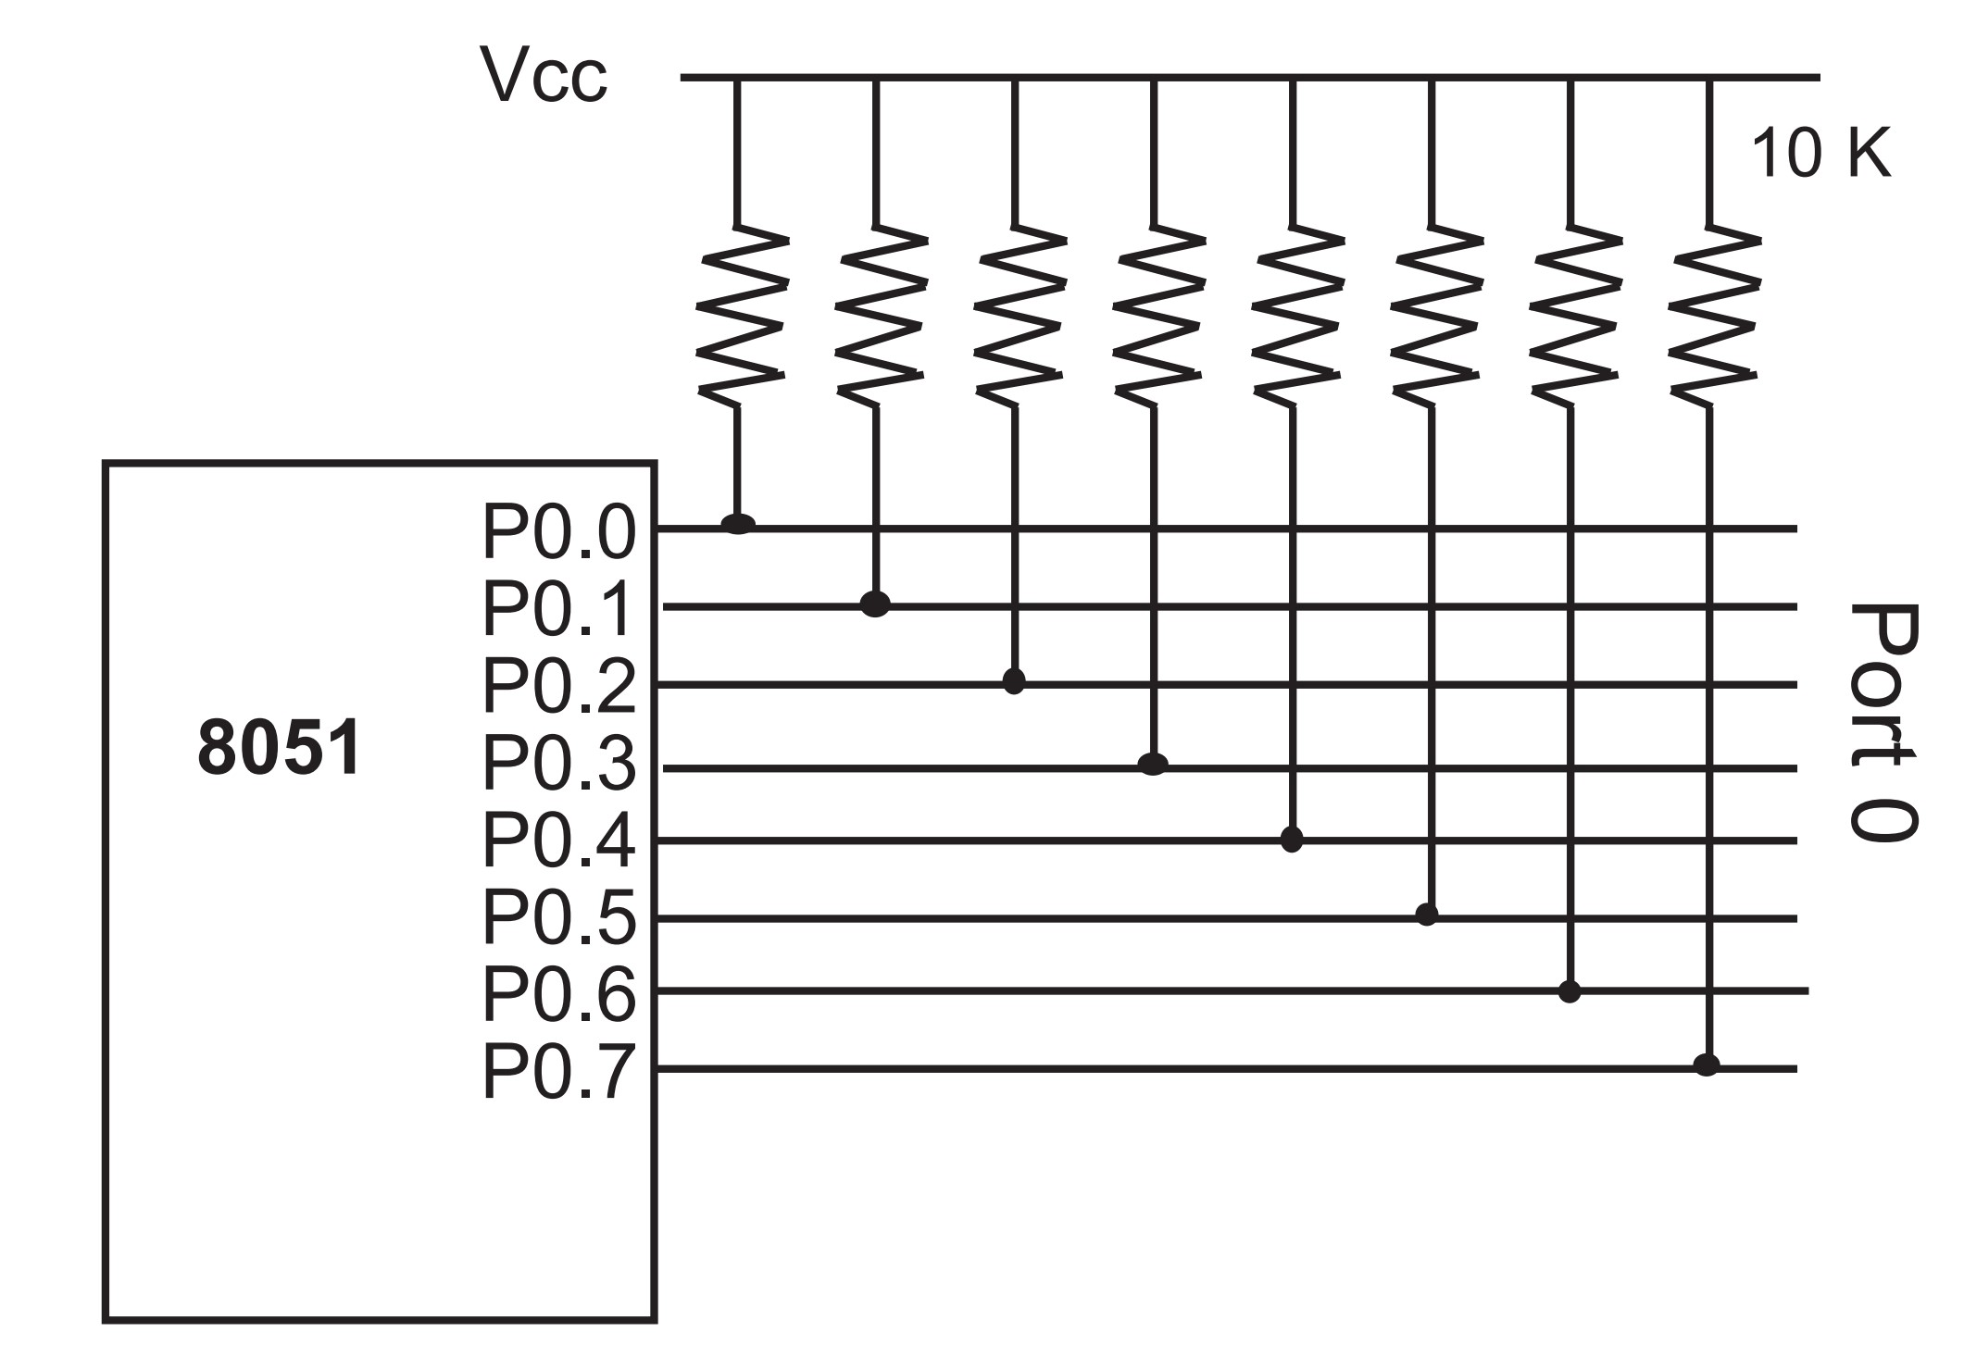
Figure 4-2. Port 0 with Pull-Up Resistors

Slide 7
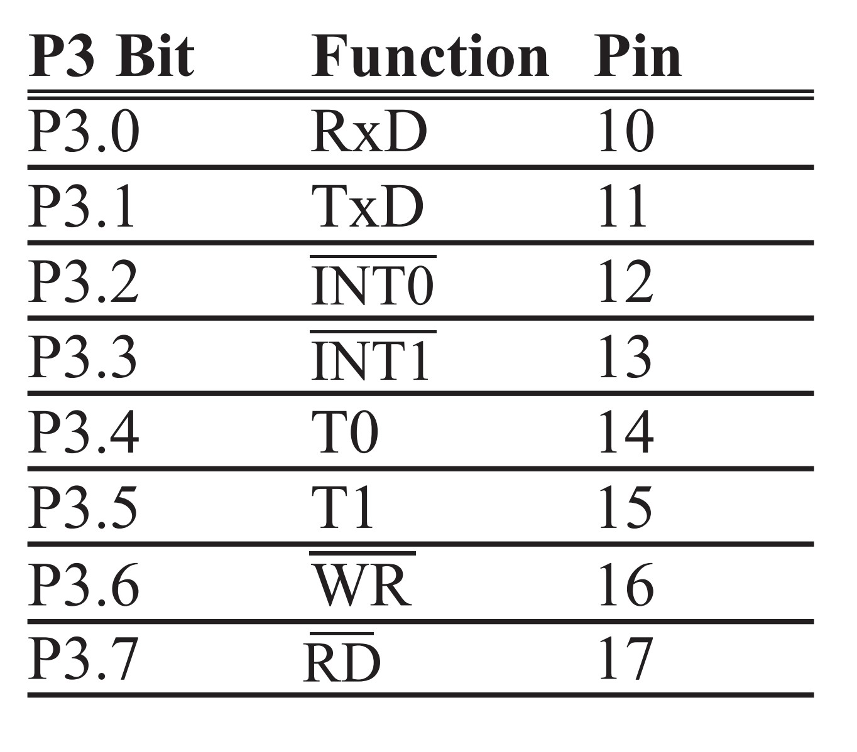
Table 4-1: Port 3 Alternate Functions

Slide 8
Solution:
Example 4-1
;Tested for the DS89C4x with XTAL = 11.0592 MHz.
ORG 0
BACK: MOV A,#55H
MOV P0,A
MOV P1,A
MOV P2,A
ACALL QSDELAY ;Quarter of a second delay
MOV A,#0AAH
MOV P0,A
MOV P1,A
MOV P2,A
ACALL QSDELAY
SJMP BACK
;-----------1/4 SECOND DELAY
QSDELAY:
MOV R5, #11
H3: MOV R4, #248
H2: MOV R3, #255
H1: DJNZ R3, H1 ;4 MC for DS89C4x0
DJNZ R4, H2
DJNZ R5, H3
RET
END
Delay = 11 x 248 x 255 x 4 MC x 90 ns = 250,430 µs
Use an oscilloscope to verify the delay size.
Write a test program for the DS89C4x0 chip to toggle all the bits of P0, P1, and P2 every 1/4 of a second. Assume a crystal frequency of 11.0592 MHz.

Slide 9
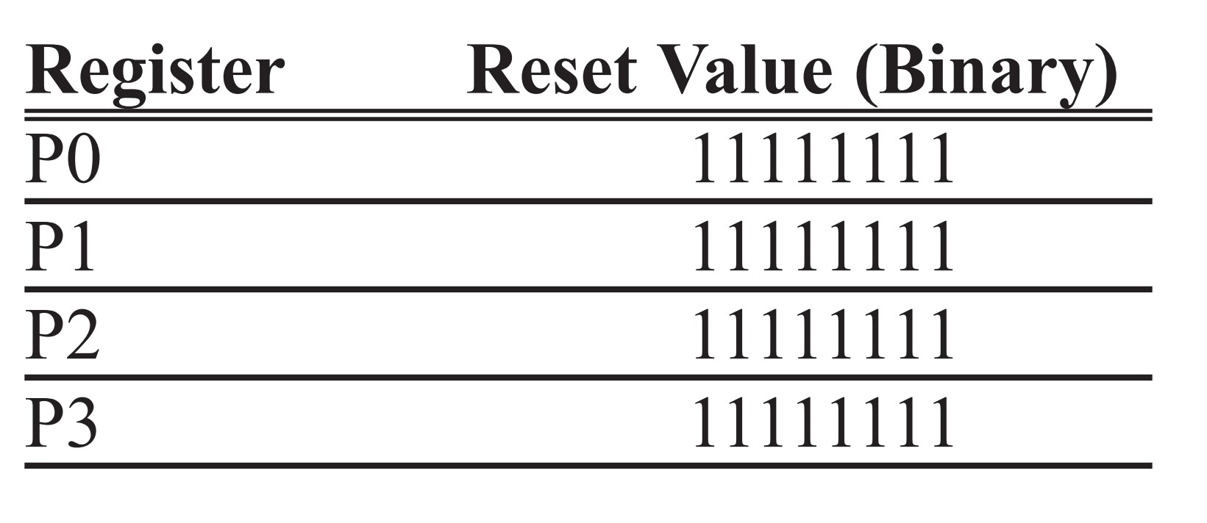
Table 4-2: Reset Value of Some 8051 Ports

Slide 10
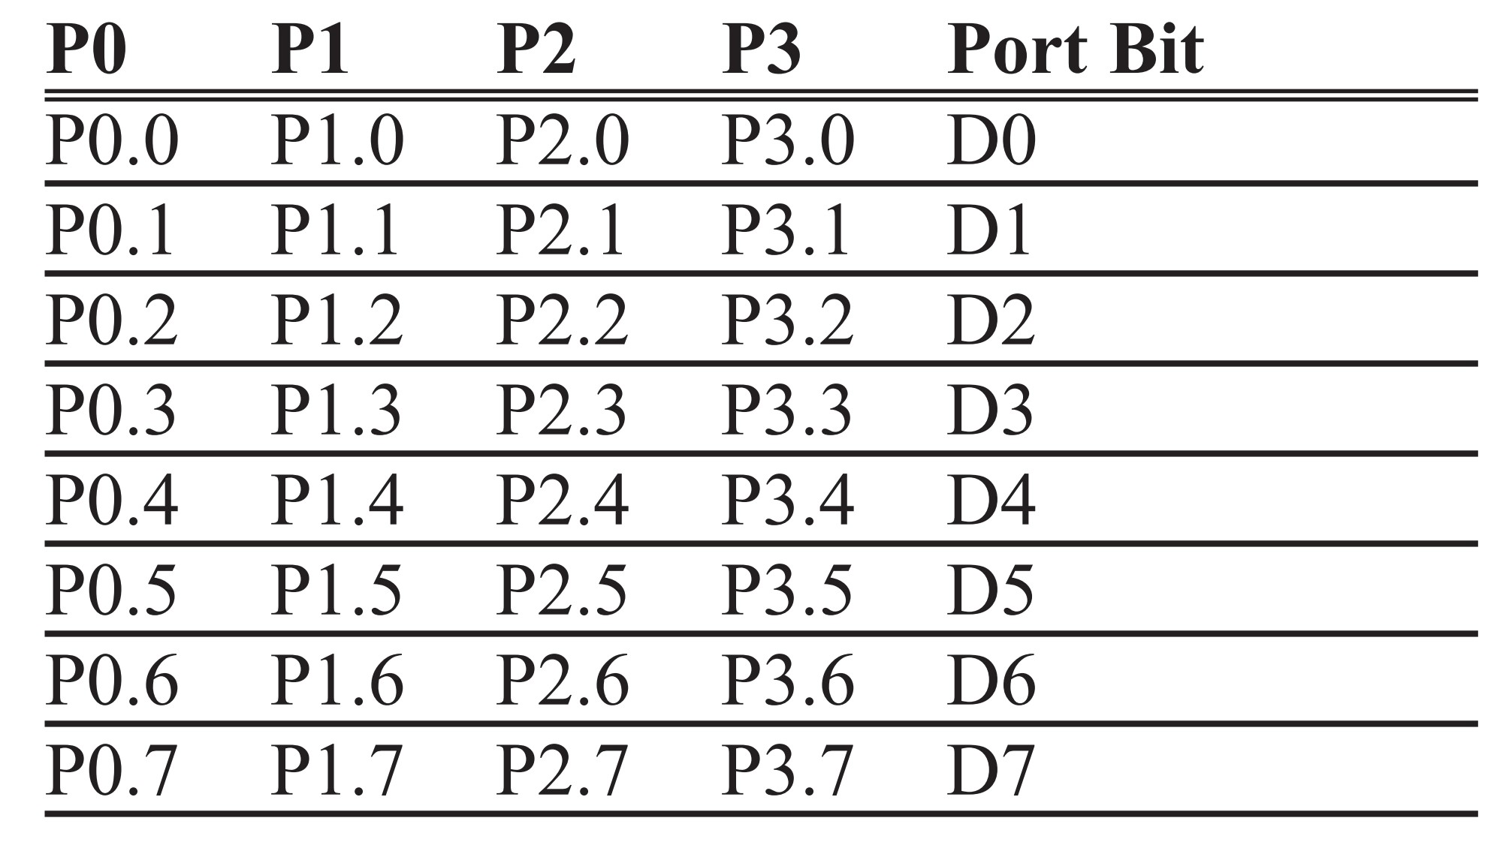
Table 4-3: Single-Bit Addressability of Ports

Slide 11
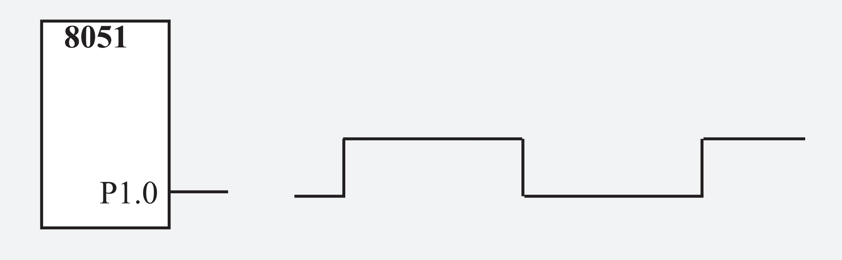
Example 4-2
Write the following programs.
(a) Create a square wave of 50% duty cycle on bit 0 of port 1.
(b) Create a square wave of 66% duty cycle on bit 3 of port 1.
Solution:
The 50% duty cycle means that the “on” and “off” states (or the high and low portions of the pulse) have the same length. Therefore, we toggle P1.0 with a time delay in between each state.
HERE: SETB P1.0 ;set to high bit 0 of port 1
LCALL DELAY ;call the delay subroutine
CLR P1.0 ;P1.0=0
LCALL DELAY
SJMP HERE ;keep doing it
Another way to write the above program is:
HERE: CPL P1.0 ;complement bit 0 of port 1
LCALL DELAY ;call the delay subroutine
SJMP HERE ;keep doing it

Slide 12
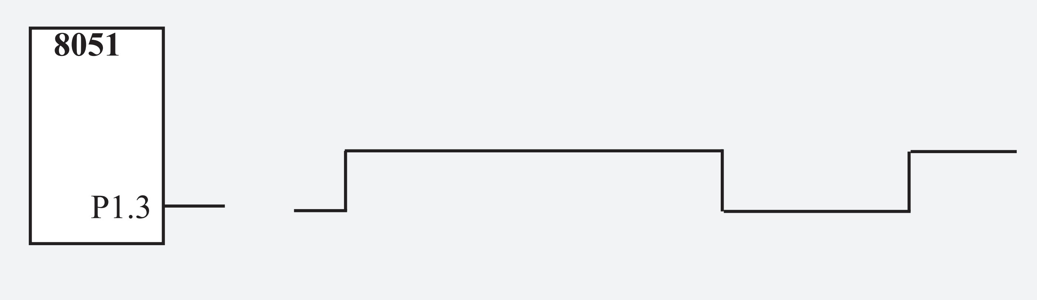
Example 4-2
Write the following programs.
(a) Create a square wave of 50% duty cycle on bit 0 of port 1.
(b) Create a square wave of 66% duty cycle on bit 3 of port 1.
Solution:
(b) The 66% duty cycle means the “on” state is twice the “off” state.
BACK: SETB P1.3 ;set port 1 bit 3 high
LCALL DELAY ;call the delay subroutine
LCALL DELAY ;call the delay subroutine again
CLR P1.3 ;clear bit 2 of port 1(P1.3=low)
LCALL DELAY ;call the delay subroutine
SJMP BACK ;keep doing it

Slide 13
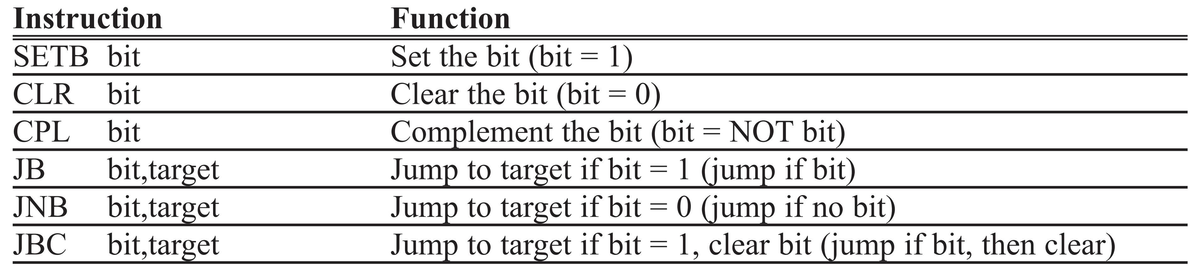
Table 4-4: Single-Bit Instructions

Slide 14
Example 4-3
Write a program to perform the following:
(a) keep monitoring the P1.2 bit until it becomes high
(b) when P1.2 becomes high, write value 45H to port 0
(c) send a high-to-low (H-to-L) pulse to P2.3
Solution:
SETB P1.2 ;make P1.2 an input
MOV A,#45H ;A=45H
AGAIN: JNB P1.2,AGAIN ;get out when P1.2=1
MOV P0,A ;issue A to P0
SETB P2.3 ;make P2.3 high
CLR P2.3 ;make P2.3 low for H-to-L
In this program, instruction “JNB P1.2,AGAIN” (JNB means jump if no bit) stays in the loop as long as P1.2 is low. When P1.2 becomes high, it gets out of the loop, writes the value 45H to port 0, and creates an H-to-L pulse by the sequence of instructions SETB and CLR.

Slide 15
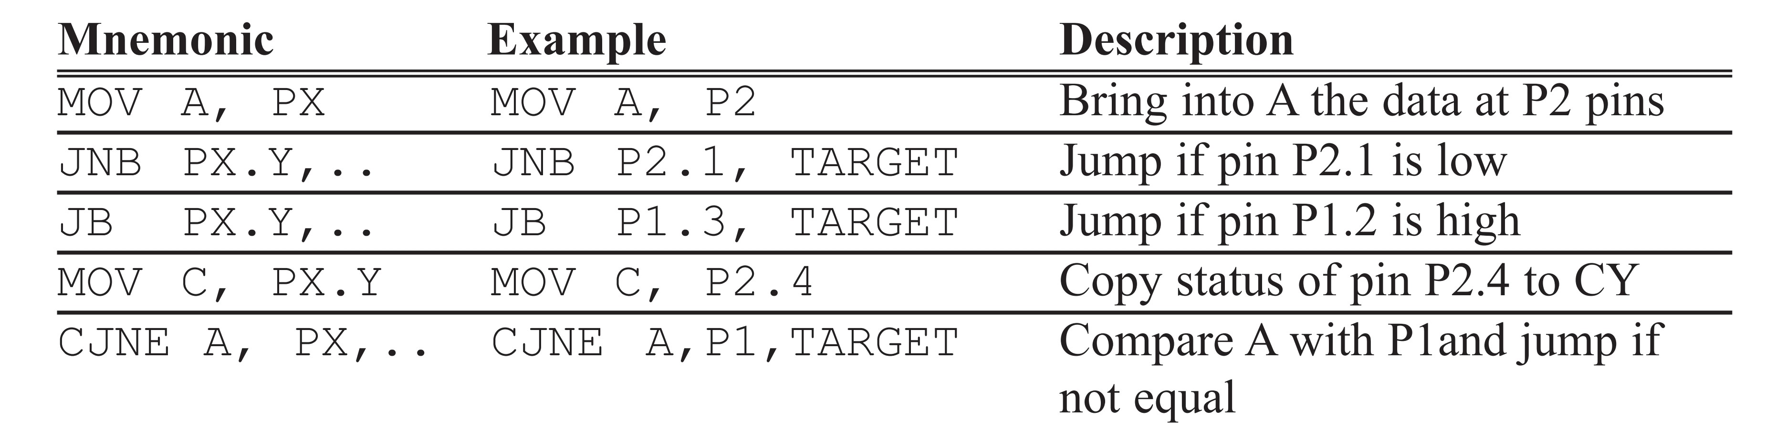
Table 4-5: Instructions For Reading the Status of an Input Port

Slide 16
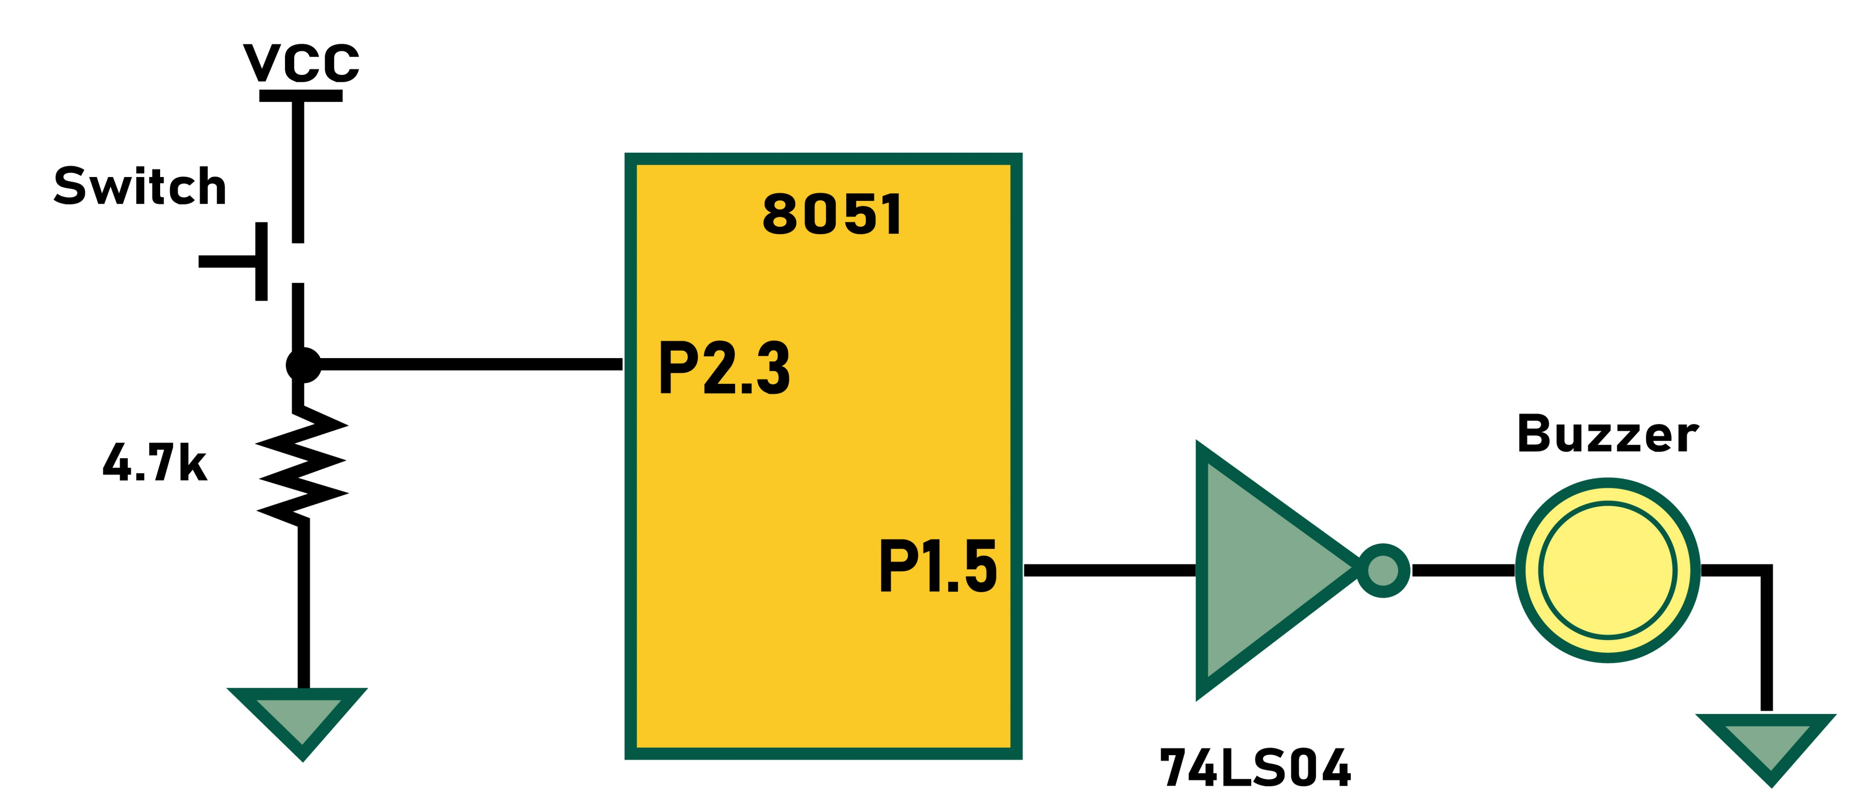
Example 4-4
Assume that bit P2.3 is an input and represents the condition of an oven. If it goes high, it means that the oven is hot. Monitor the bit continuously. Whenever it goes high, send a high-to-low pulse to port P1.5 to turn on a buzzer.
Solution:
HERE:JNB P2.3,HERE ;keep monitoring for high
SETB P1.5 ;set bit P1.5=1
CLR P1.5 ;make high-to-low
SJMP HERE ;keep repeating

Slide 17
Example 4-5
A switch is connected to pin P1.7. Write a program to check the status of SW and perform the following:
(a) If SW=0, send letter ‘N’ to P2.
(b) If SW=1, send letter ‘Y’ to P2.
Solution:
SETB P1.7 ;make P1.7 an input
AGAIN: JB P1.2,OVER ;jump if P1.7=1
MOV P2,#'N' ;SW=0, issue 'N' to P2
SJMP AGAIN ;keep monitoring
OVER: MOV P2,#'Y' ;SW=1, issue 'Y' to P2
SJMP AGAIN ;keep monitoring

Slide 18
Example 4-6
A switch is connected to pin P1.7. Write a program to check the status of the switch and perform the following:
(a) If switch = 0, send letter ‘N’ to P2.
(b) If switch = 1, send letter ‘Y’ to P2.
Use the carry flag to check the switch status. This is a repeat of the last example.
Solution:
SETB P1.7 ;make P1.7 an input
AGAIN: MOV C,P1.2 ;read the SW status into CF
JC OVER ;jump if SW = 1
MOV P2,#'N' ;SW = 0, issue 'N' to P2
SJMP AGAIN ;keep monitoring
OVER: MOV P2,#'Y' ;SW = 1, issue 'Y' to P2
SJMP AGAIN ;keep monitoring

Slide 19
Example 4-7
A switch is connected to pin P1.0 and an LED to pin P2.7. Write a program to get the status of the switch and send it to the LED.
Solution:
SETB P1.7 ;make P1.7 an input
AGAIN: MOV C,P1.0 ;read the SW status into CF
MOV P2.7,C ;send the SW status to LED
SJMP AGAIN ;keep repeating
Note: The instruction “MOV P2.7, P1.0” is wrong since such an instruction does not exist. However, “MOV P2, P1” is a valid instruction.

Slide 20
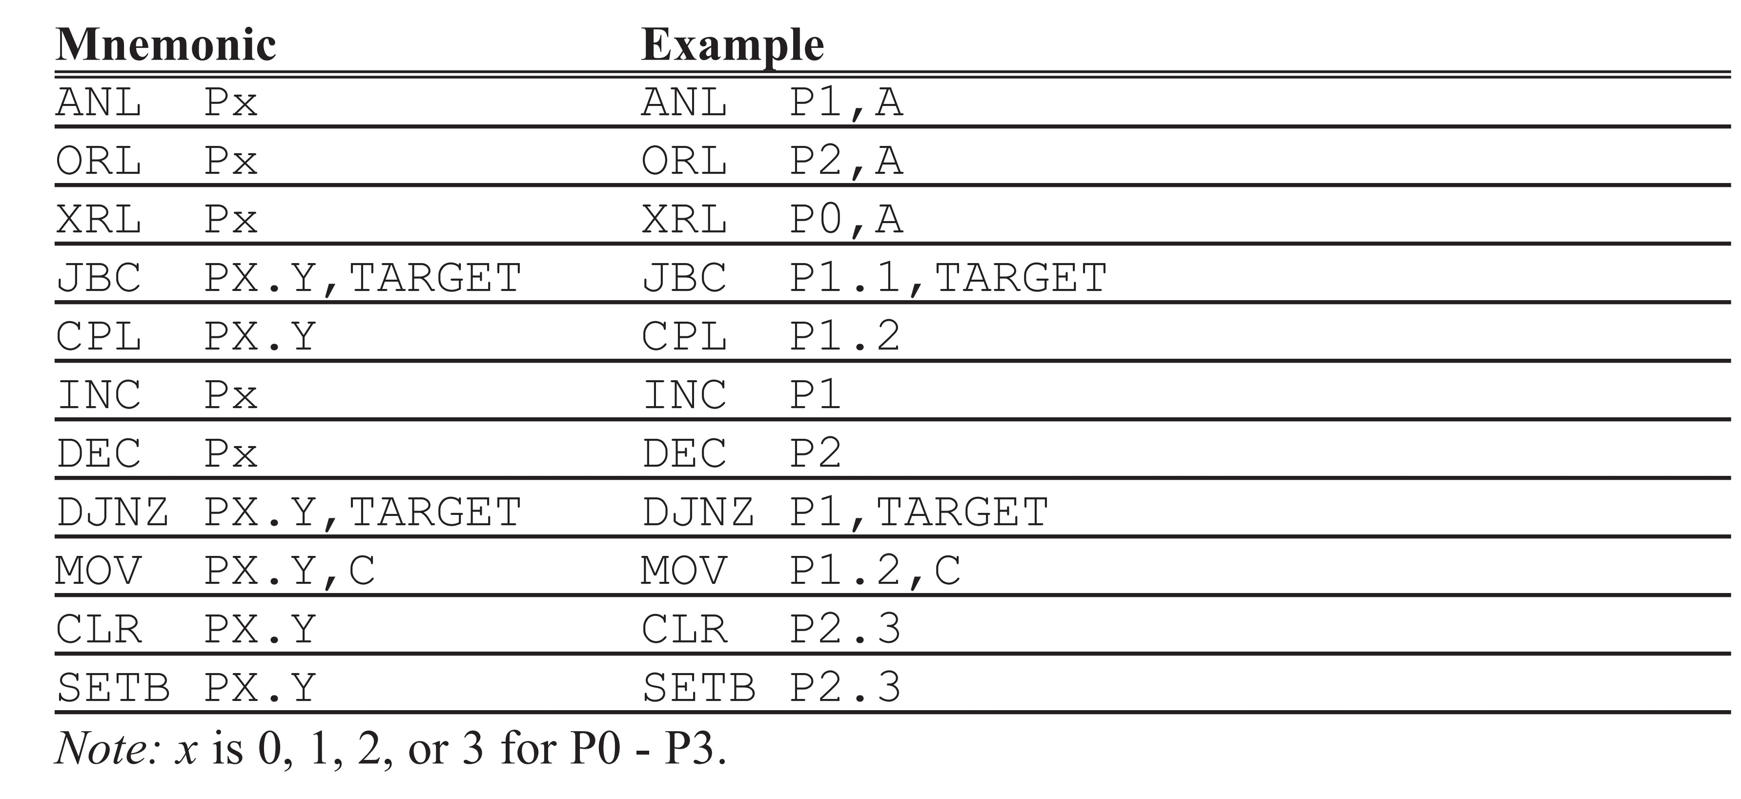
Table 4-6: Instructions Reading a Latch (Read-Modify-Write)

